Slide 1
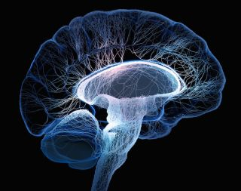
X-Linked ALD
Nikhil Desen

Slide 2
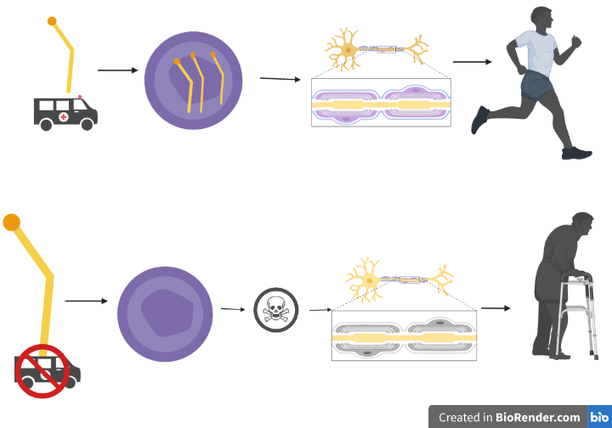
What is X-linked ALD?

Slide 3
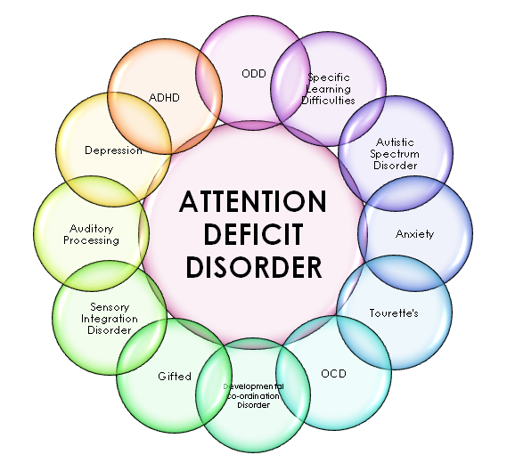
What are the symptoms of ALD?

Slide 4
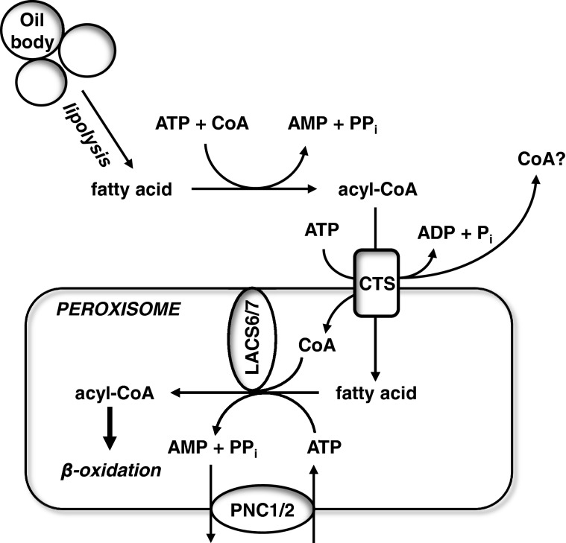
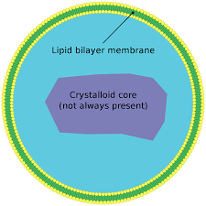
What gene is responsible?
ABCD1
Marked areas are probable for mutation in ALD.
Molecular Function
Biological Process
Cellular Component

Slide 5
How well is the gene conserved?
Human
ABC_membrane_2
ABC_tran
745 AA
Goat
737AA
Drosophila
730AA
Zebrafish
766 AA
Elephant Shark
248 AA
Transporter
Transporter

Slide 6
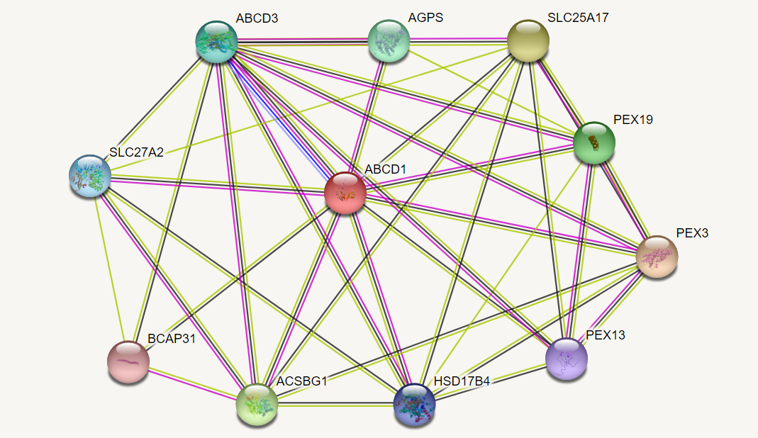
Protein Interaction: ABCD1

Slide 7
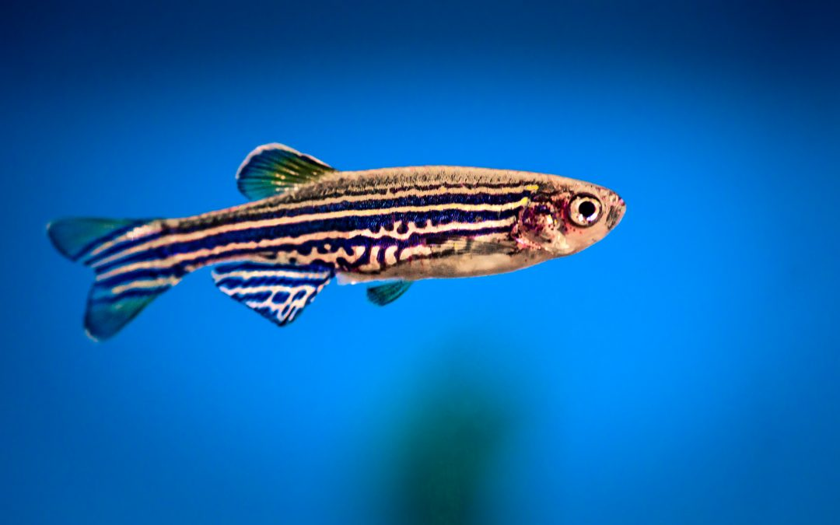
What is the model organism of choice?
Cheap
Many Offspring
Rapid Growth
Transparency
Eggs Outside

Slide 8
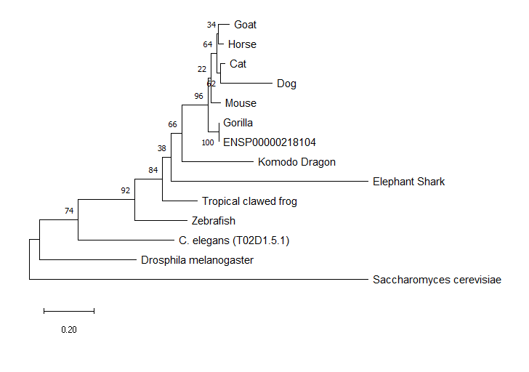
Phylogeny
Zebrafish and humans have their abcd1 genes fairly conserved.

Slide 9
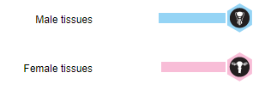
What is the gap?
Although males are more susceptible to the disease given that it is x-linked, why do males experience more severe versions of the disease than females?

Slide 10
What is the primary goal?
To determine what may be the cause of increased severity of ALD in males.
Aim 1
Aim 2
Aim 3
Identify regions responsible for transporter function.
Look at differential expression of genes in ABCD1 mutant male and females.
Hypothesis: Differential expression in males could lead to more extreme cases of ALD.

Slide 11
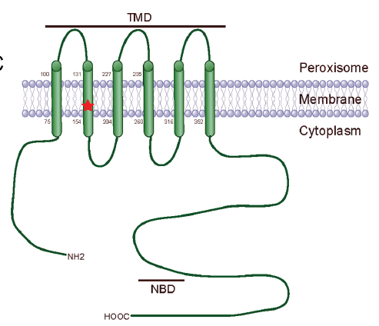
Aim 1: Identify regions of the protein responsible for transporter function.
Use clustalomega to find homologs of sequences in zebrafish shown to cause the mutation.

Slide 12
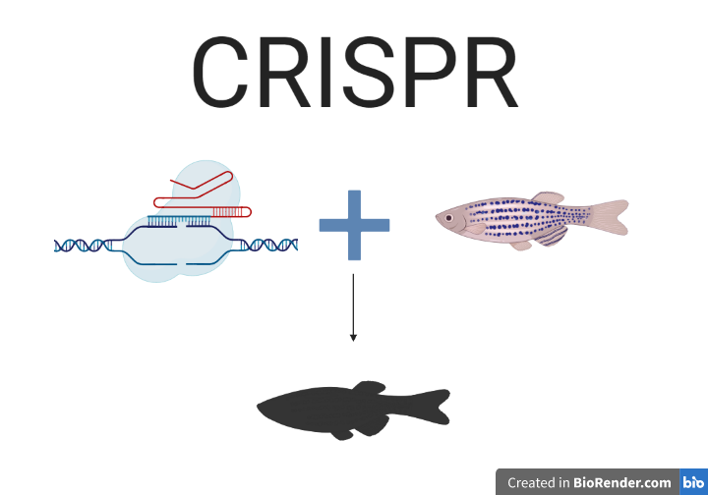
Aim 1: Identify regions of the protein responsible for transporter function.

Slide 13
Aim 1: Identify regions of the protein responsible for transporter function.

Slide 14
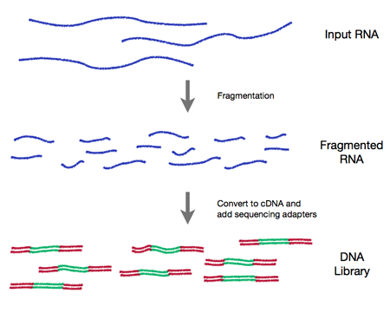
Aim 2: Look at gene expression of differentially expressed genes in males and females.
Why: Given that the expression levels of the gene are about the same, there must be another factor playing a part.

Slide 15
Future Directions: Upregulation of the ABCD2 gene.
https://www.ncbi.nlm.nih.gov/pmc/articles/PMC2967711/

Slide 16
Image References
https://www.google.com/imgres?imgurl=https%3A%2F%2Fupload.wikimedia.org%2Fwikipedia%2Fcommons%2Fthumb%2Fc%2Fcb%2FPeroxisome.svg%2F1200px-Peroxisome.svg.png&imgrefurl=https%3A%2F%2Fen.wikipedia.org%2Fwiki%2FPeroxisome&tbnid=hEp91eL7de9viM&vet=12ahUKEwjU_O28n9LoAhXHNawKHXvwCf0QMygBegUIARCFAg..i&docid=bQv55noxXvaxKM&w=1200&h=1200&q=peroxisome%20structure&hl=en&ved=2ahUKEwjU_O28n9LoAhXHNawKHXvwCf0QMygBegUIARCFAg

Slide 17
References
https://www.ncbi.nlm.nih.gov/pmc/articles/PMC4652930/
Yan, Fang & Wang, Wenbo & Ying, Hui & Li, Hongyu & Chen, Jing & Xu, Chao. (2017). S149R, a novel mutation in the ABCD1 gene Causing X-linked adrenoleukodystrophy. Oncotarget. 8. 10.18632/oncotarget.20974.
https://www.google.com/url?sa=i&url=https%3A%2F%2Frnaseq.uoregon.edu%2F&psig=AOvVaw0gw9RG6H4-hKM1n0AGvweR&ust=1586232730563000&source=images&cd=vfe&ved=0CAIQjRxqFwoTCMDo1MX30ugCFQAAAAAdAAAAABAO

